Slide 1

COMP47250: Team Software Project
PRESENTATION 4
6th JULY, 2020

Slide 2

Team Rocket
Aditya Krishnan 15316048
Apurva Deore 19200283
Ashwin Manikandan 19201000
Minaz Shaikh 19200200
Nripendra Singh 19200326
Sumit Kumar 19200701
Vishal Padma 19200174

Slide 3






Project objectives
Challenge 1: COVID-19
COVID-19 INTERACTIVE VISUALIZER

Slide 4
AIM Creation of a Web-based Chatbot Application and Map Visualizer which would enable us to solve user queries regarding the COVID-19 pandemic across the world. We aim to create more awareness among people regarding the effects of the pandemic specifically in the health sector, i.e Infected rates, Death rates, Recovery rates, etc, by letting users directly interact with the chatbot. The web page will use trusted sources to gather relevant information in the aforementioned categories which will be used to drive the responses of the bot and power the map based visualizations of the world which will be also deployed on the same application.
We plan to achieve two paramount features
CHATBOT
A chatbot which would answer user’s queries about COVID-19.
Eg: Symptoms of COVID-19?
INTERACTIVE MAP
An interactive map-based feature deploying visualizations that provide statistics about COVID-19 of various countries.
E.g. Total cases? Active cases?

Slide 5
Project Plan
After having achieved partial V1.2, lacking the integration of the chatbot with the front end pf the application, we aim to further breakdown tasks and reach goals into sprints and release versions. As part of the main non-trivial extension we would like to first refine the scope of the chatbot to being strictly restricted to information regarding Ireland.
Version 2.0 (7th July – 13th July’20)
Reviewing the Lex API and identifying the constraints to develop two-three core intents which will be deployed from start to end. Integration of second API with the existing data.
Version 2.1 (14th July – 20th July’20)
Refining the functionality of the application to better improve User Experience and integration of the chatbot to the existing web application, With finer implantation of previous work done.
Version 2.2 (21st July – 28th July’20) 🡪 Milestone 2/Final Product
Final core implementations and refinement of the paramount tasks (House the Chat-Bot and prepare the map visualizations) before the deployment of the application for user testing and evaluation and subsequent preparation of the final report.

Slide 6
Roles
Aditya and Minaz (Front-End Team) Decide on the UI design and layout and functionality of the Webpage with the subsequent creation of Front-End.
Integration of the Front-End with the Back-End. Refine the Web page with improved functionality to help better the UX
Apurva and Vishal (Data and Visualization Team) Research on the second potential API required and write scripts for Data Collection.
Data Mining and Data Cleaning/Pre-processing as and when required.
NLP Processing for Text and research/deploy visualizations.
Ashwin (Cloud Deployment Team) Test/Deploy the required resources (Data Lake/ PostgreSQL/Data Factory/DB).
Create dummy scripts and trigger them using data factory pipelines.
Research on how to connect PostgreSQL to Front-end.
Sumit and Nripendra (Django Team)
Analyze for the risks involved and prepare .Net Backup
Prepare the structure of Lex API, and develop intents based on user requirements.
Creation of Back-End and integration with the front-end.

Slide 7
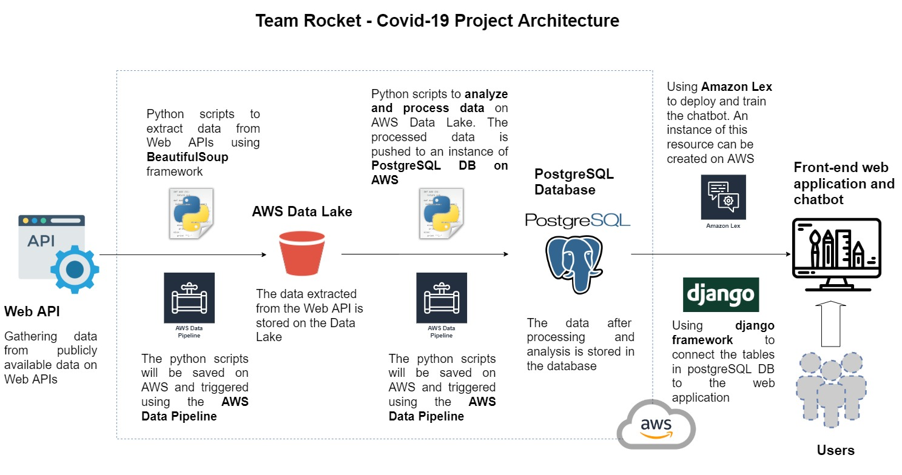
Architecture

Slide 8
DATA PLAN
Data to be considered
We are considering data from various APIs; We scoured the web for COVID-19 API’s or other implementations of centralized world data regarding the pandemic. We plan to consider two broad types : DYNAMIC and STATIC data. Once the data is collected and curated, we aim to filter the type of queries the bot is able to answer.
DYNAMIC / LIVE DATA
-Statistics of COVID-19 cases Per Country [Real Time Data, Updating regularly]
Total cases
Active cases
Recovered cases
Deceased cases
Tests done
https://api.covid19api.com/summary
https://api.covid19api.com/countries
https://raw.githubusercontent.com/microsoft/Bing-COVID-19-Data/master/data/Bing-COVID19-Data.csv
https://www.programmableweb.com/api/yatko-coronavirus-map-rest-api-v10https://api.quarantine.country/api/v1/summary/latest
The Yatko API provides us with extra statistical info for the following categories:-
Tests done
Critical Cases
Death Ratio/Recovery Ratio
Taking this API for the additional info provided and integrating it with the John Hopkins data, we are now able to get additional information for 186 countries.
The Bing-COVID-19 API is being taken into consideration to keep a tab on the data collected from Johns Hopkins, to handle any data discrepancies if and when present in the data hierarchy.

Slide 9
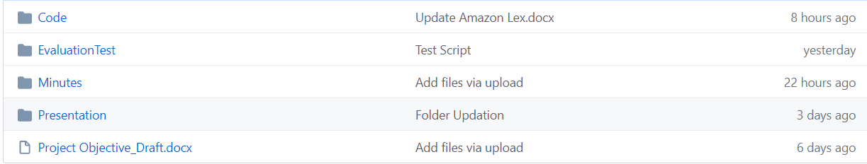
GitHub
Work done until now; like ideas proposed, minutes of meetings, any research done so far related to the project, has been pushed onto our team’s repository.
We’ve created different folders and are constantly push-committing the work as and when it is completed.
Just to give a gist…

Slide 10
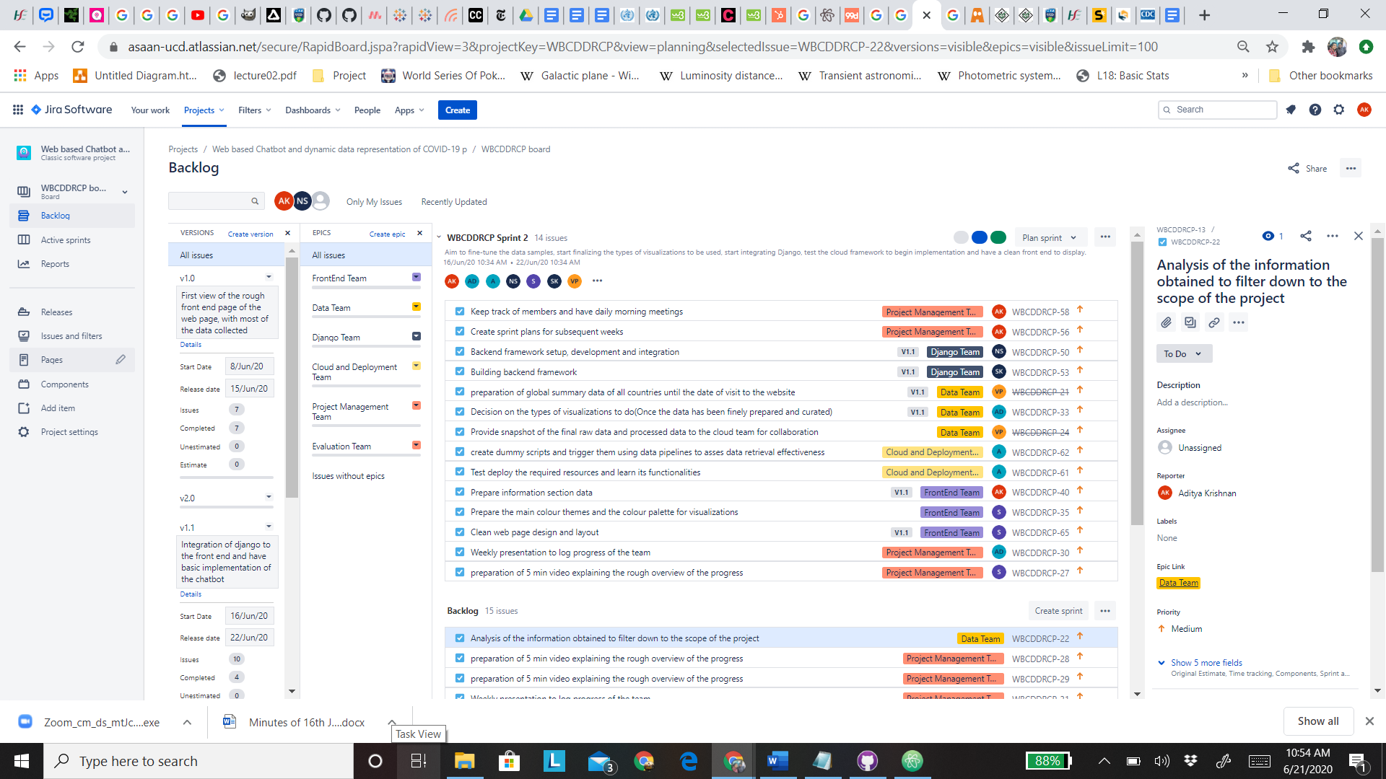
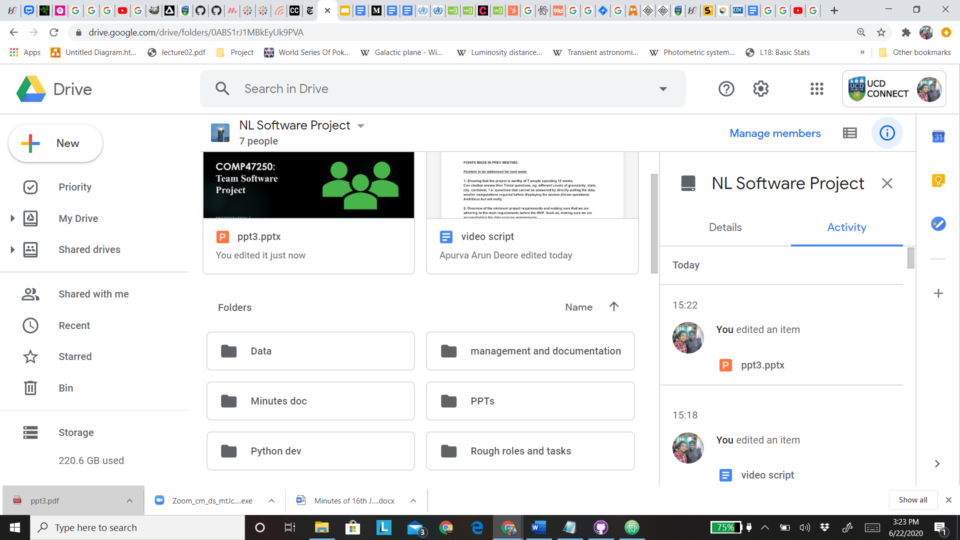
Team Management
Team progress managed by Sumit and Aditya:
Shared google drive folder which contains all the different folders for each team consisting of basically all of the data cumulated at one place for enhanced availability and accessibility, including the log of each MOM and documenting the progress of the team at each stage.
Conducting daily meetings via Google Meet and logging MOM of each meeting
We’re using Jira to outline each team member’s work, define sprints, plan the work to be done and the corresponding deadlines for them.
Just to give you a gist, you can see on the right; our Jira board with tasks allocated and our shared folder on Google Drive.

Slide 11
Progress So Far..
Front-End
Reviewing the main colour themes and the colour palette for visualizations.
Clean the front-end of the web application design and structuring the layout of the pages accordingly.
Researching potential features for better UX
Data
Researched/Finalized the potential 2nd API to use (main focus on the John Hopkins API, with Yatko as second)
Scripts written for the collection of raw data from the desired sources (CSV format).
Integration of the summary data from both the API and the final merged Dataset set for each country which will be later used in the visualization.
Test Evaluation Scripts
Creation of a User Test Case script template and a peer review template.

Slide 12
Cloud Architecture
Created basic pipelines to connect the file system with the data lake.
Creating dummy scripts and triggering them using data factory pipelines.
Based on the research on which platform is best suited for the project between AWS and Azure, we are considering the possibility of using azure given the ease of use of the platform.
Django Framework
Review LEX API, to identify constraints and capabilities in full
Reorganise the structure to narrow the scope of the queries that is aimed to be fulfilled.
Prepare for development of a user intent for deployment from start to finish.

Slide 13
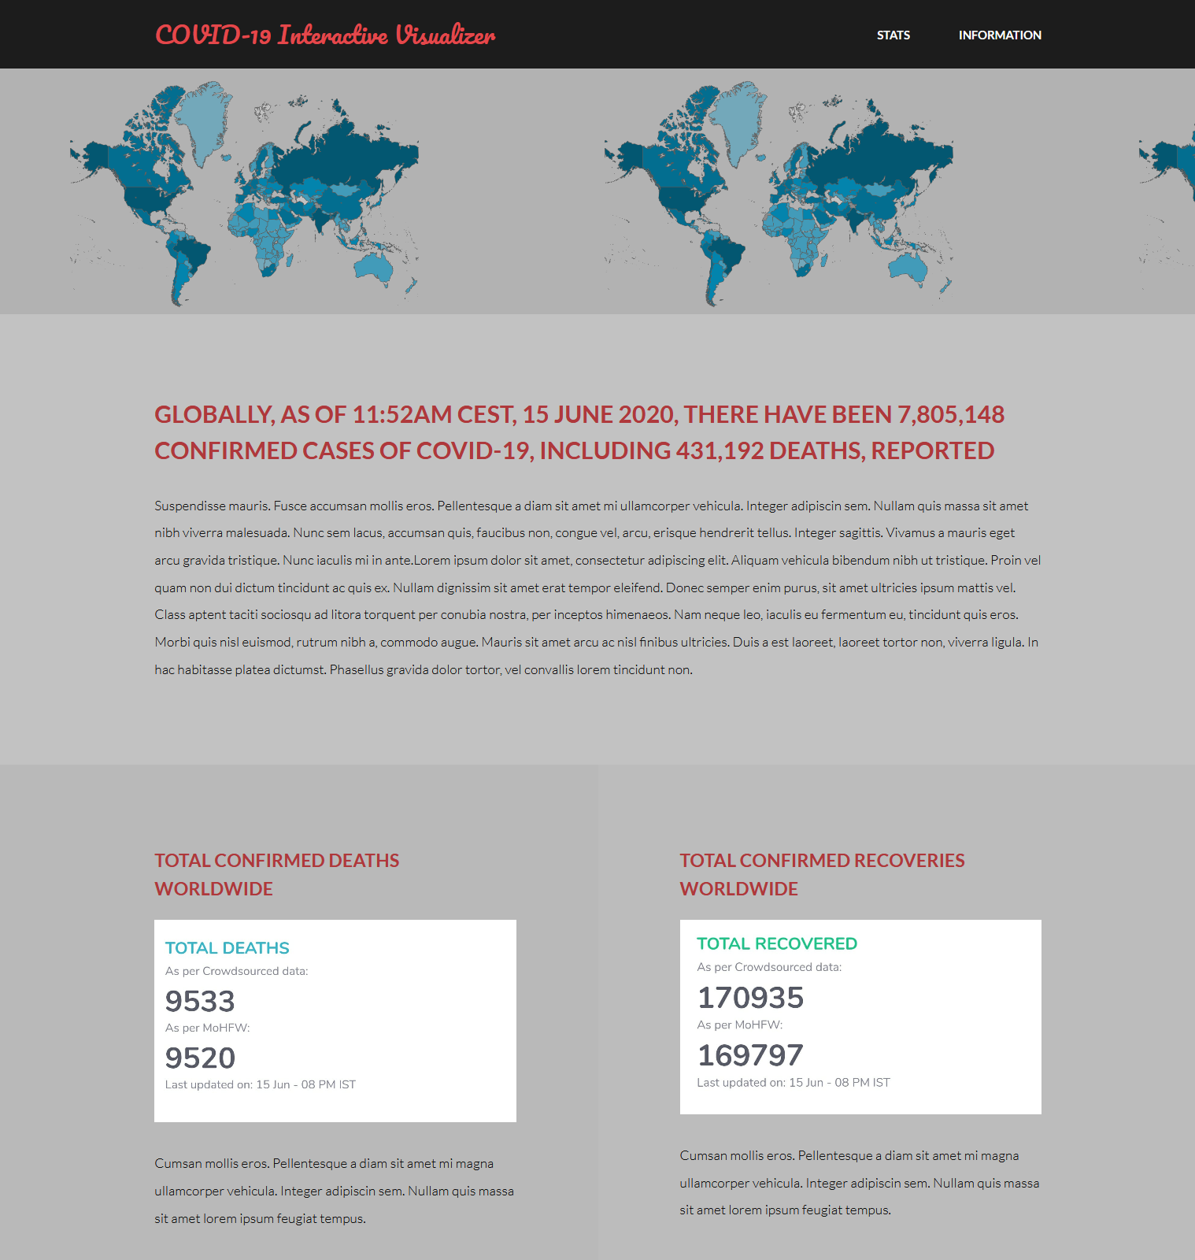
Just a gist of what our
web-page would look like!

Slide 14
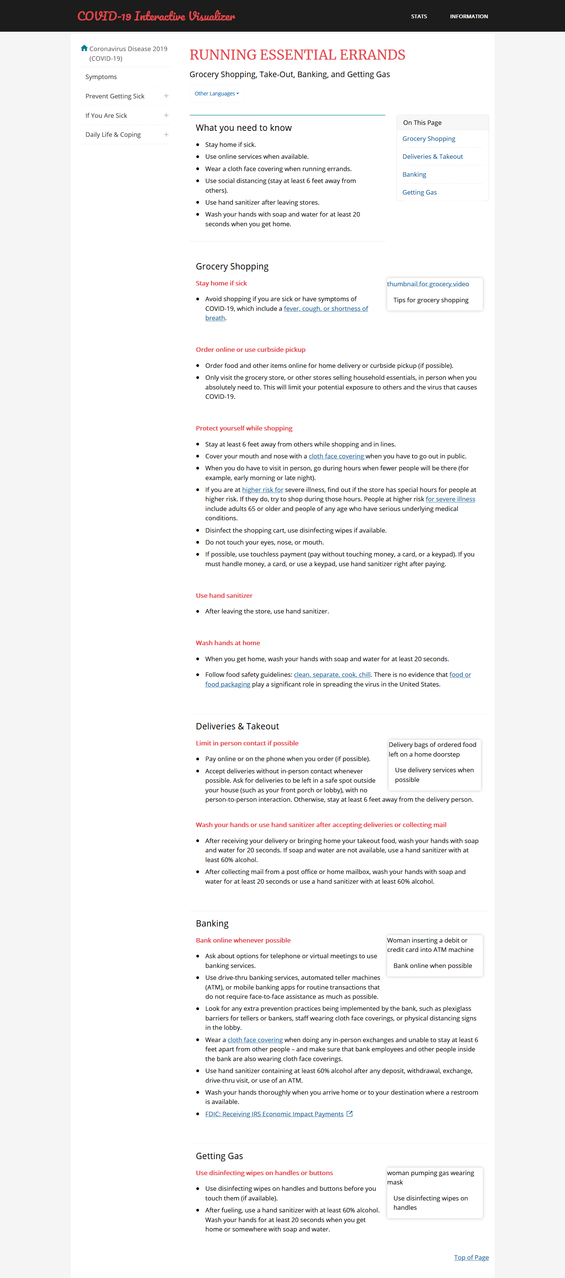
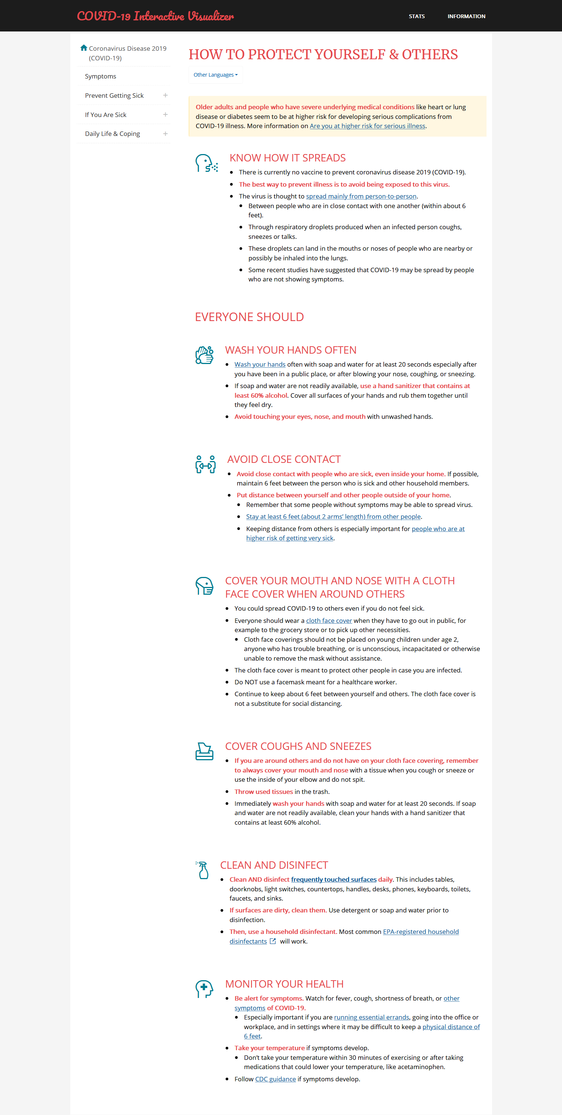
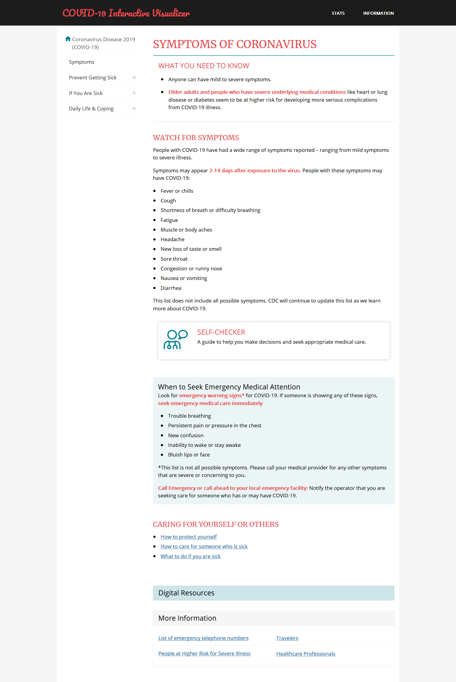

Slide 15
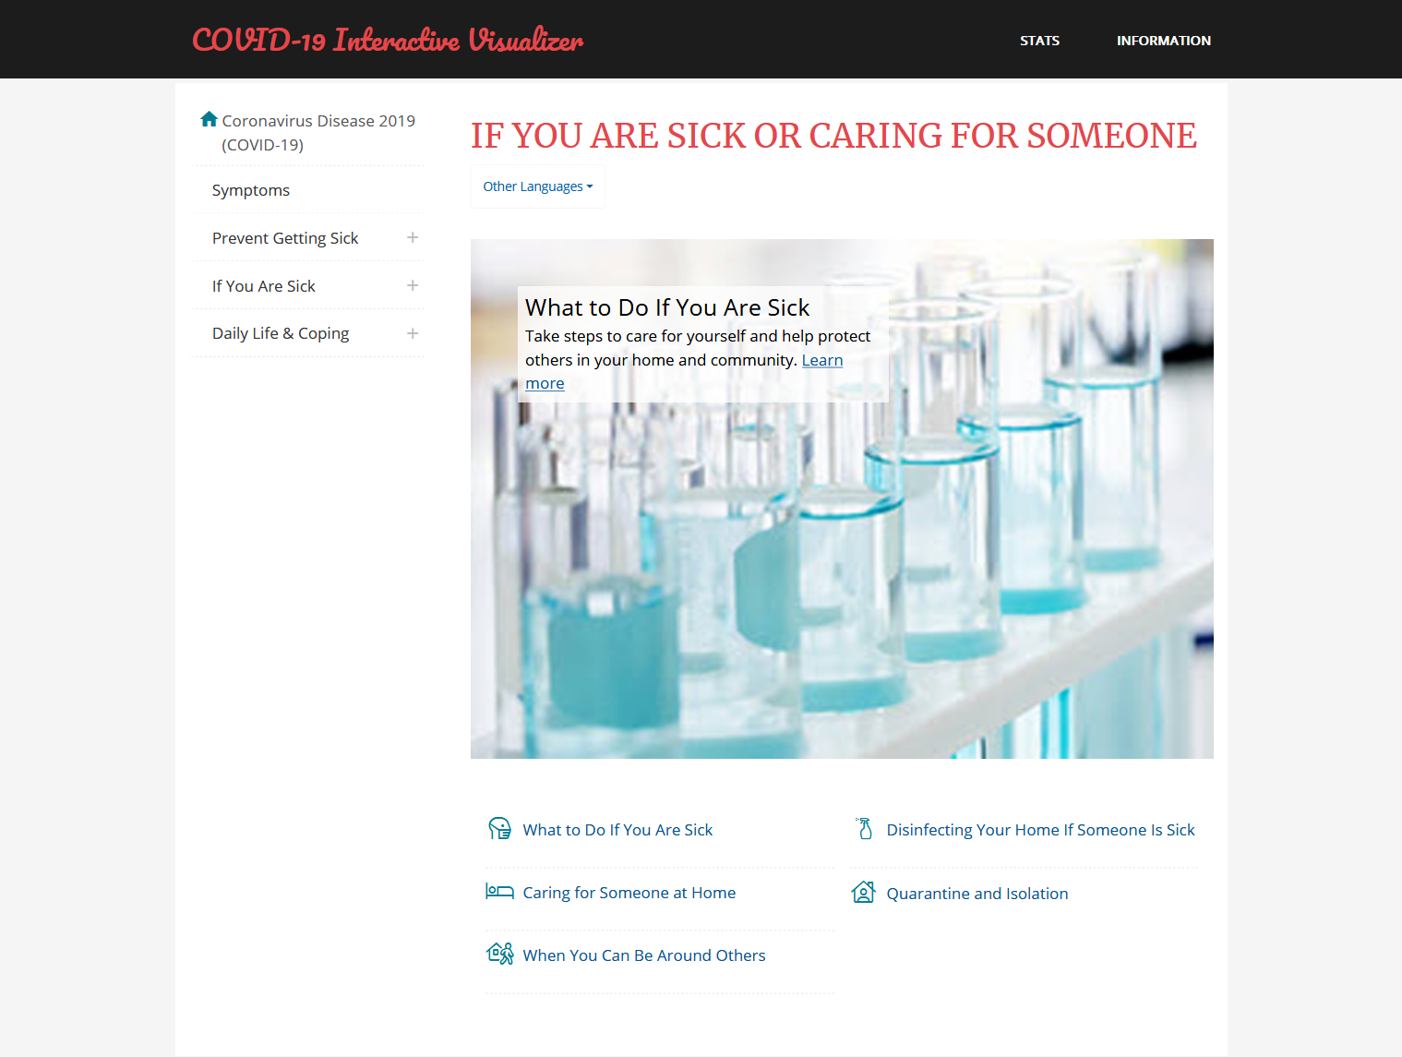
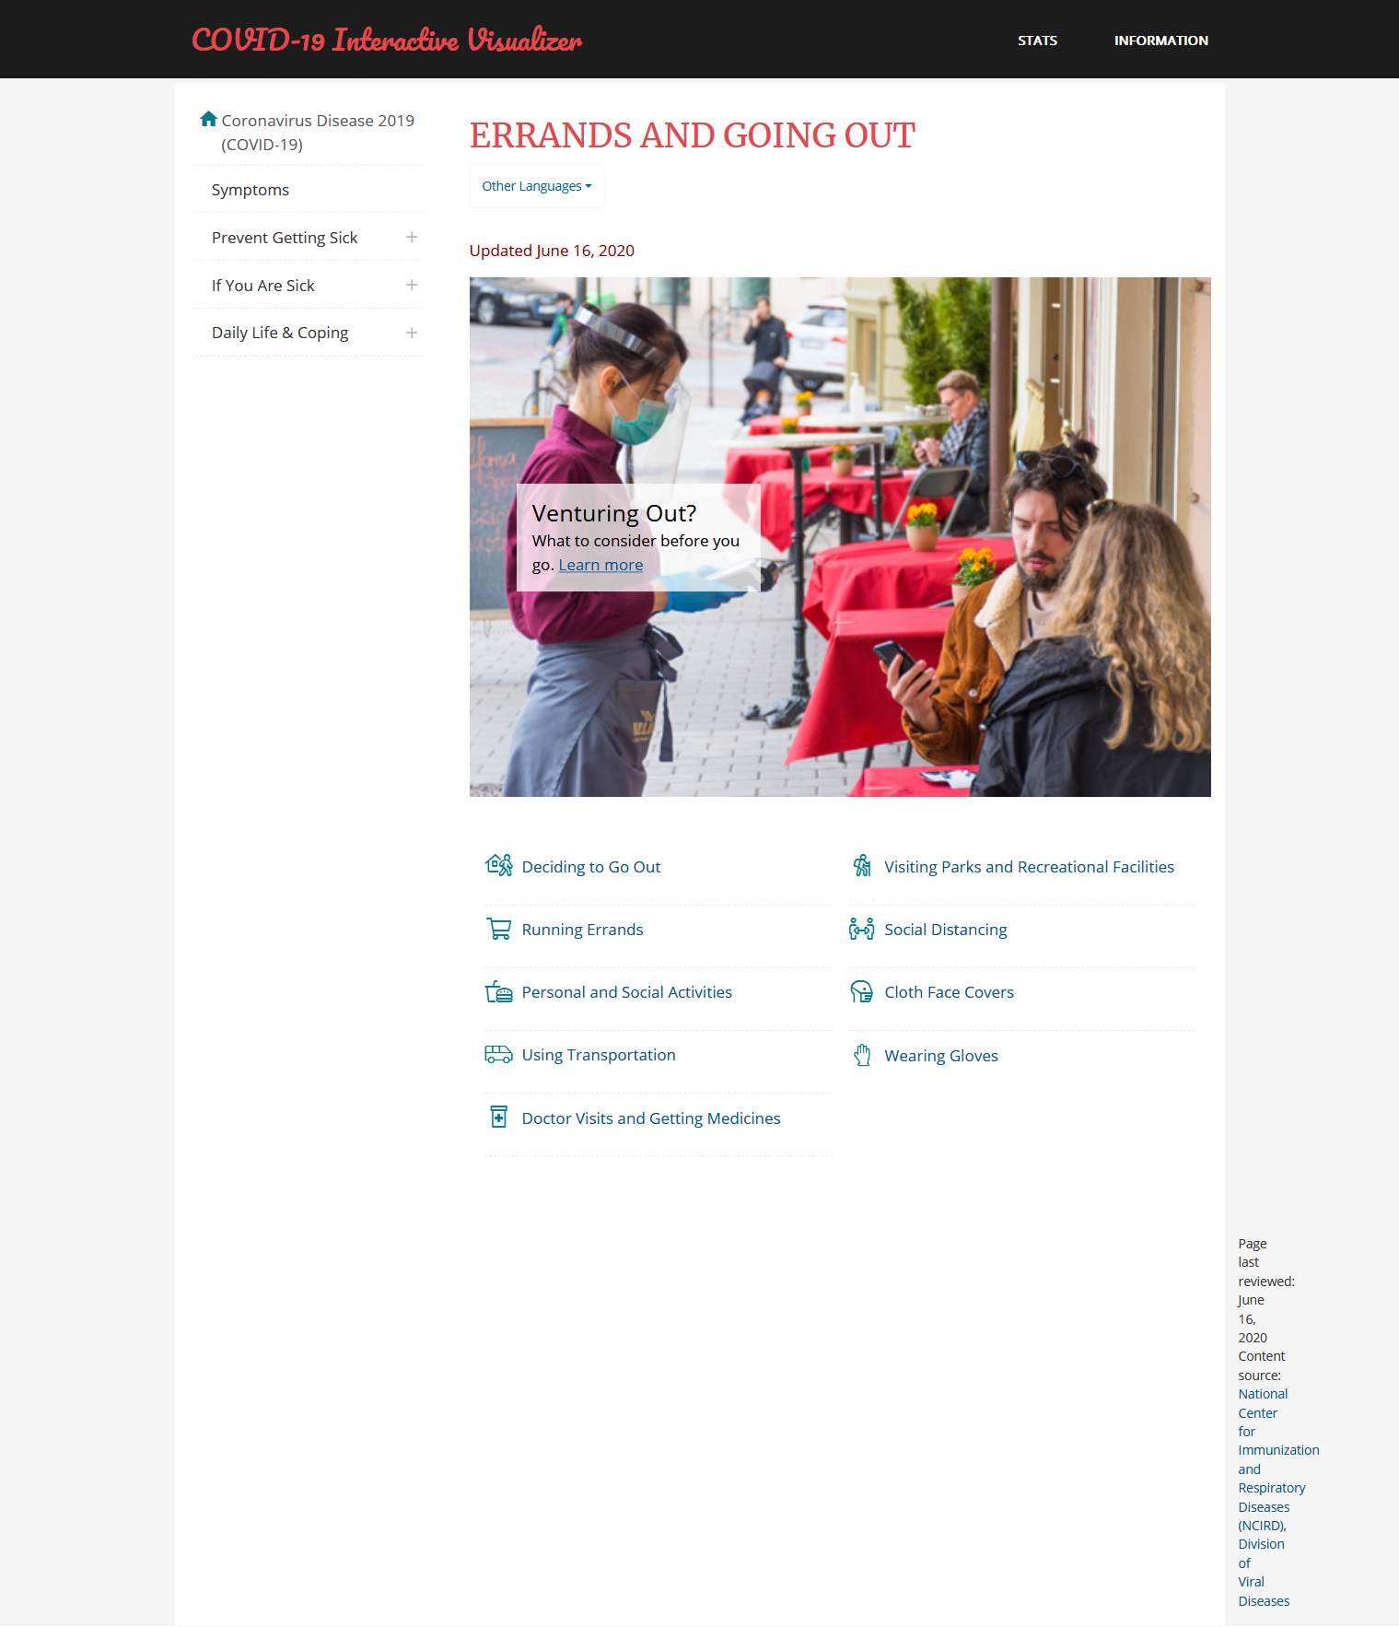

Slide 16
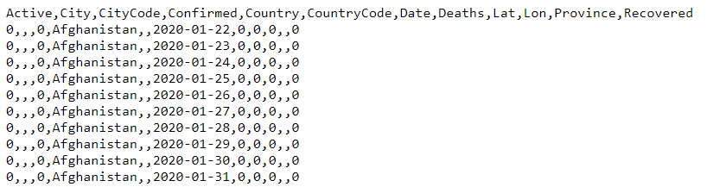
This is the TIME_SERIES data which would be mainly used for visualizations to show trends that each country has observed so far for the counts of confirmed/Recovered/Active/ Deceased cases.
Data & Visualizations

Slide 17
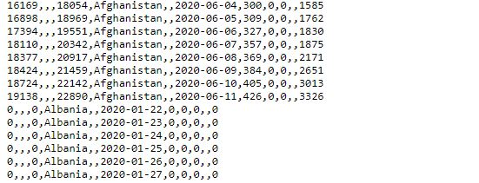

Slide 18
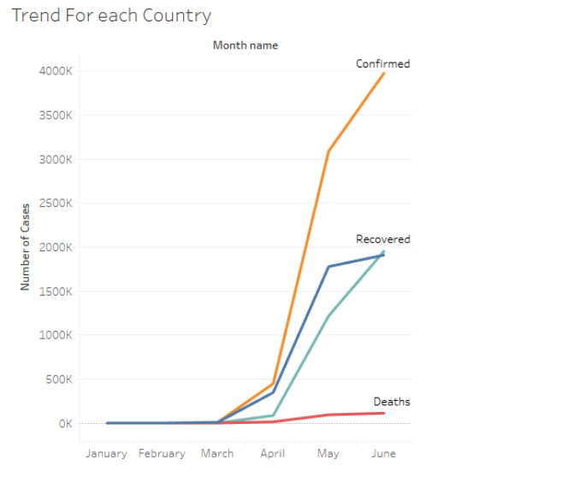
The previous slide’s Data would be used for Trend Visualizations as much mentioned before.

Slide 19
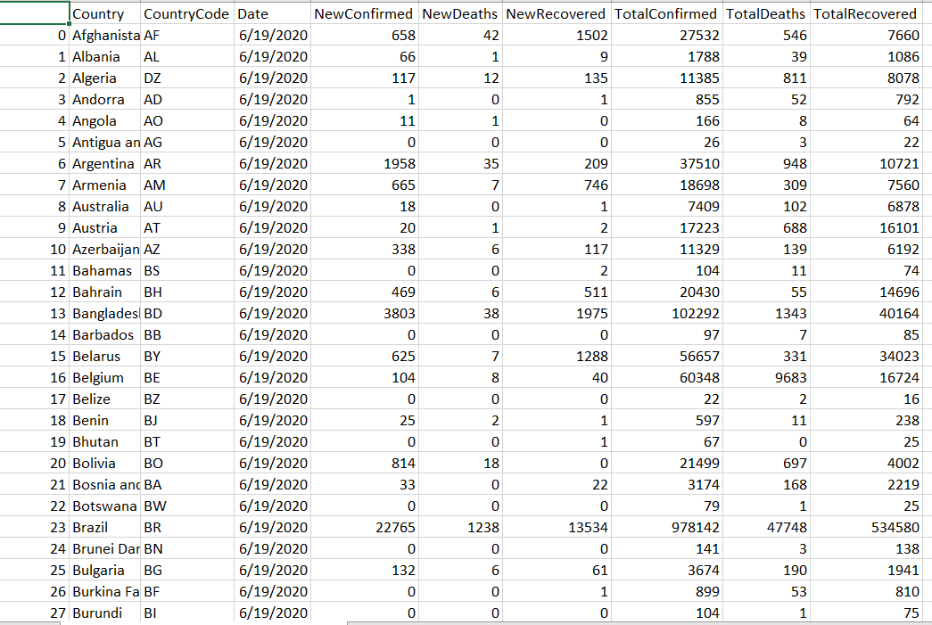
This is the summarized data which provides us with 6 counts: New Confirmed, New Deaths, New Recovered, Total Confirmed, Total Deaths, Total Recovered for all countries on the date of visit.

Slide 20
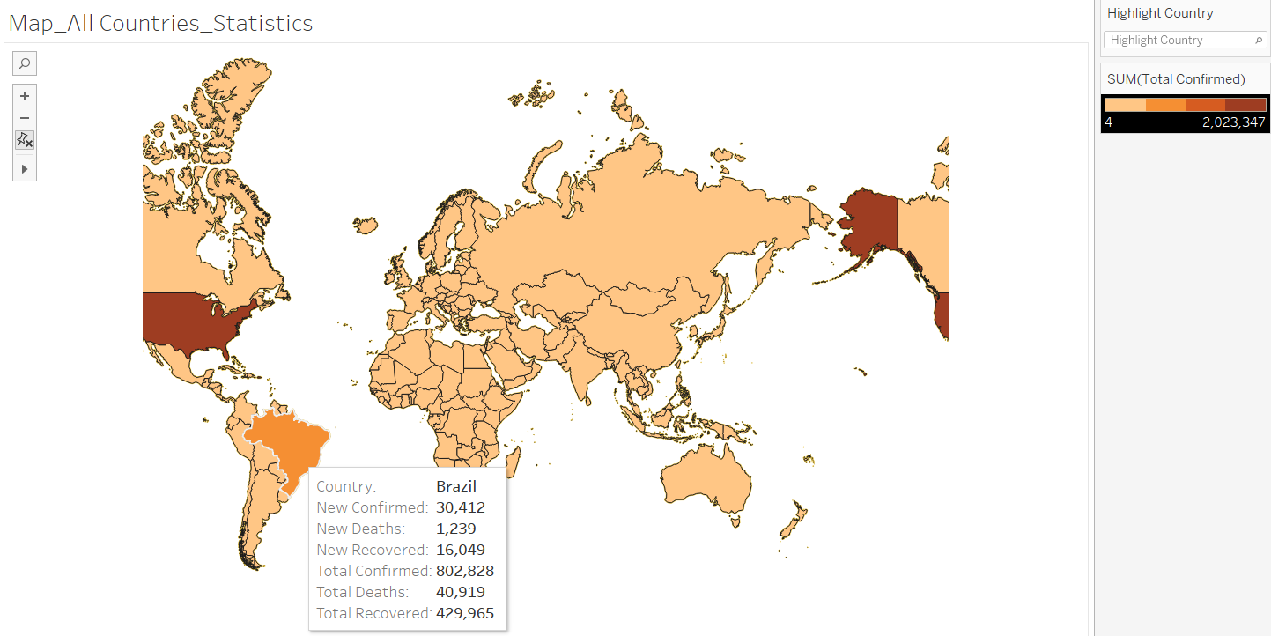
When we hover over a country, we’d be provided with the statistics for that country. Also, the intensity of the colour used increases as the count of Total Confirmed cases increase. We can see, USA has been assigned the darkest shade possible in the range. You can see the colour shade used on the top-right most side of the picture.

Slide 21
STAY SAFE!
THANK YOU!
-Team Rocket

